Slide 1


MACHINE LEARNING
LAB10 SVM
贾艳红 Jana
Email:jiayh@mail.sustech.edu.cn

Slide 2


Outline
Intro. to Linear separability
Intro. to Support Vector Machine (svm) classifier

Slide 3
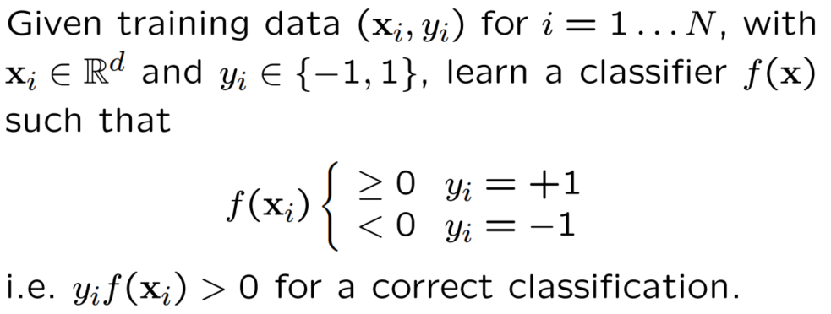
Binary Classification

Slide 4
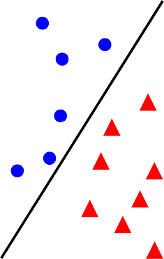

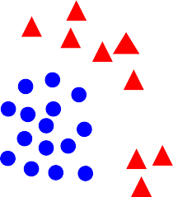

Linear separability
linearly separable
not linearly separable

Slide 5
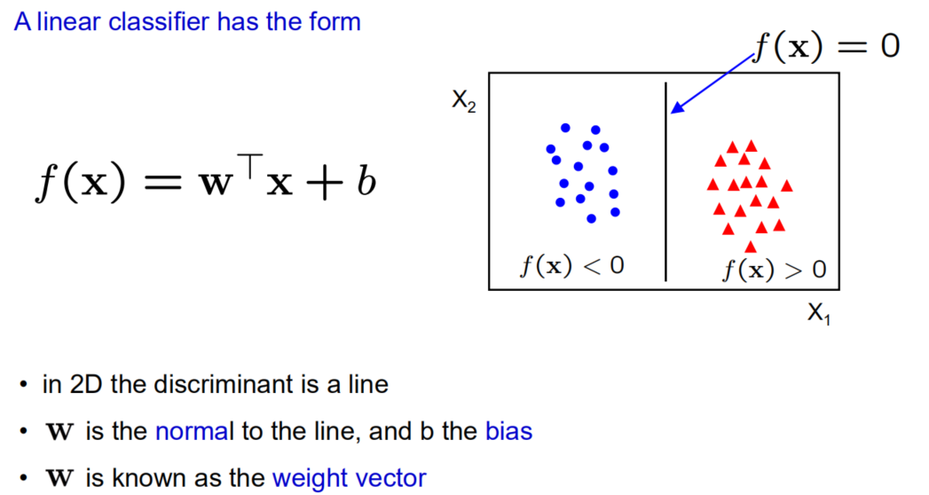
Linear classifiers

Slide 6
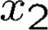
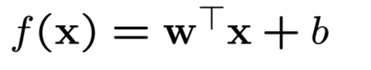
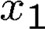
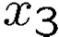
Linear classifiers
A linear classifier has the form
f (x) = 0
in 3D the discriminant is a plane, and in nD it is a hyperplane
For a linear classifier, the training data is used to learn w and then discarded
Only w is needed for classifying new data

Slide 7
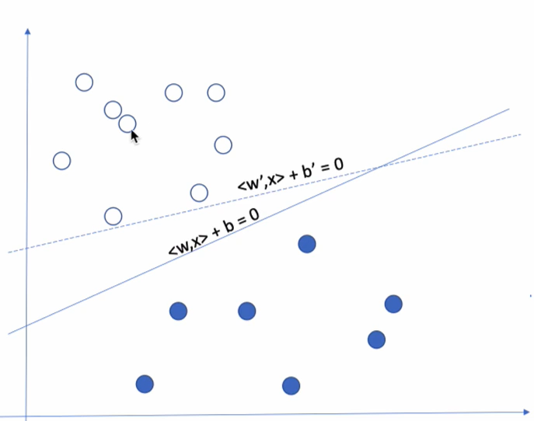
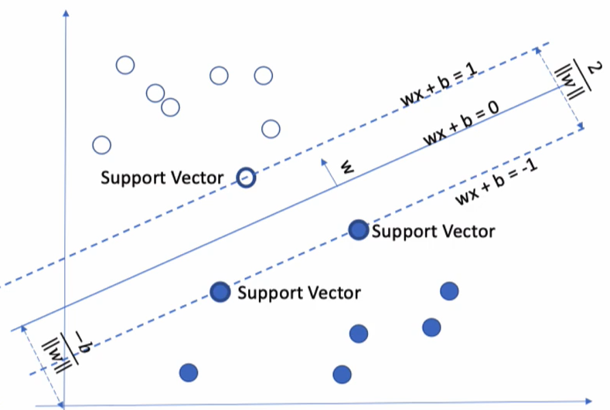
What is the best w?
Linear classifier
svm

Slide 8
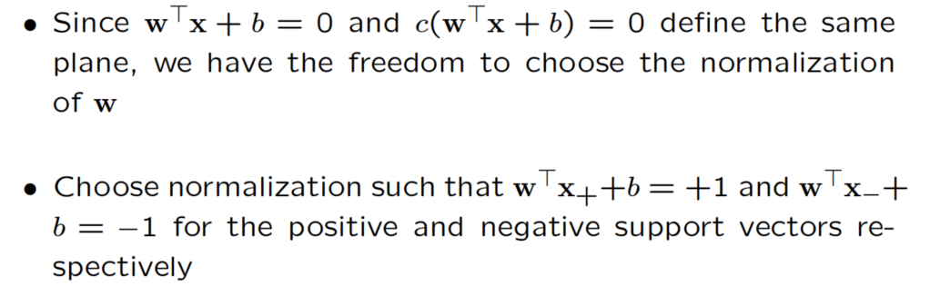
SVM – sketch derivation

Slide 9
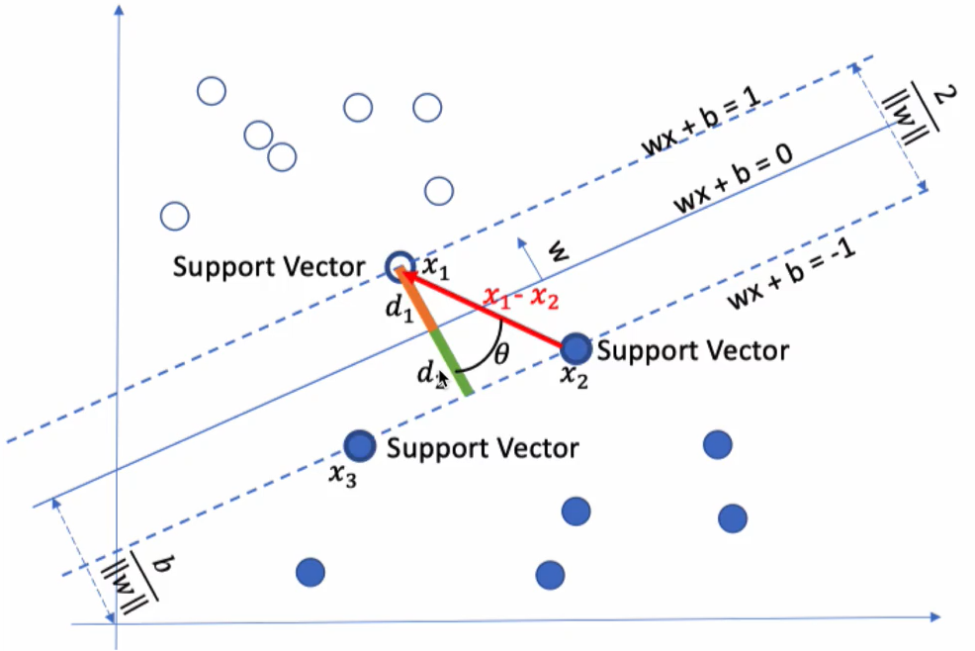
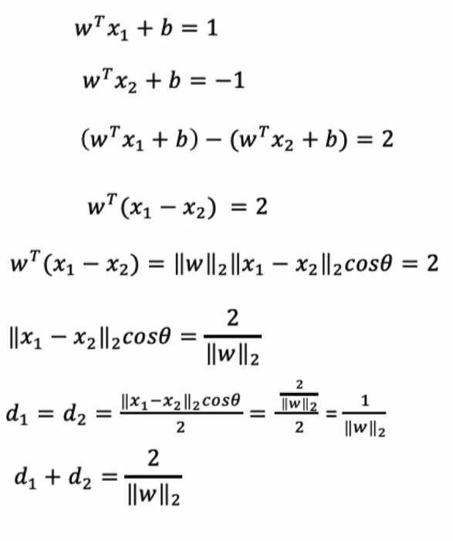
SVM – sketch derivation
SVM are also called max-Margin Classifer

Slide 10
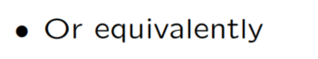
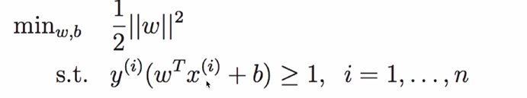
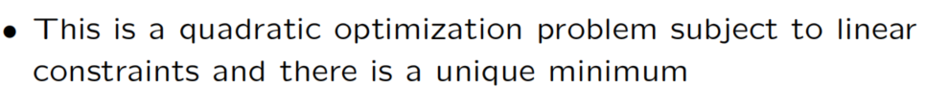
SVM – Optimization

Slide 11
The Optimization Problem Solution
The solution involves constructing a dual problem where a Lagrange multiplier α_{i} is associated with every constraint in the primary problem:
Find α₁…α_{N} such that
Q(α) =Σα_{i} - ½ΣΣα_{i}α_{j}y_{i}y_{j}x_{i}^{T}x_{j} is maximized and
(1) Σα_{i}y_{i} = 0
(2) α_{i} ≥ 0 for all α_{i}

Slide 12
The Optimization Problem Solution
The solution has the form:
Each non-zero α_{i} indicates that corresponding x_{i} is a support vector.
Then the classifying function will have the form:
Also keep in mind that solving the optimization problem involved computing the inner products x_{i}^{T}x_{j} between all pairs of training points.
w =Σα_{i}y_{i}x_{i} b= y_{k}- w^{T}x_{k} for any x_{k} such that α_{k}≠ 0
f(x) = Σα_{i}y_{i}x_{i}^{T}x + b

Slide 13
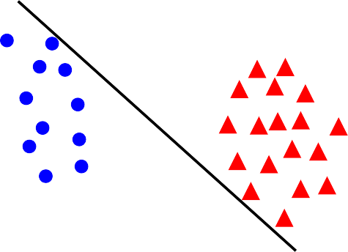

Linear separability again: What is the best w?
the points can be linearly separated but there is a very narrow margin
but possibly the large margin solution is better, even though one constraint is violated
In general there is a trade off between the margin and the number of mistakes on the training data

Slide 14
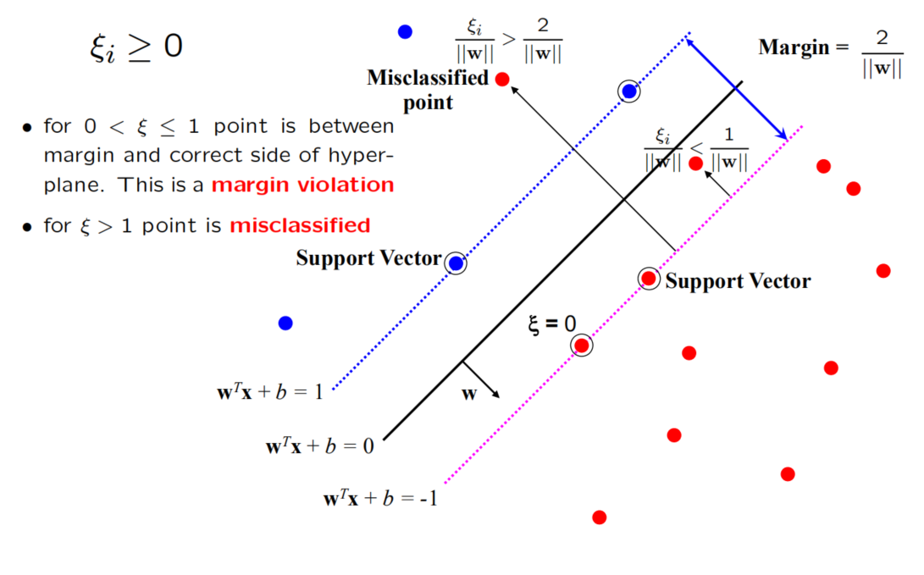
Introduce “slack” variables

Slide 15
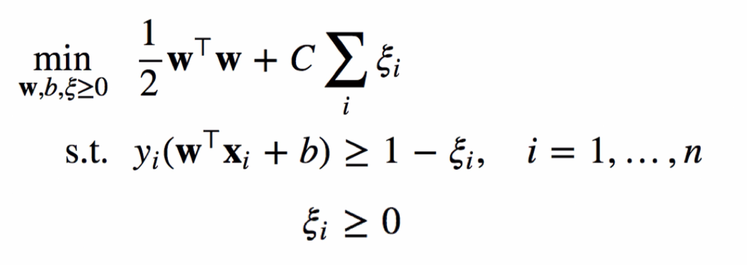
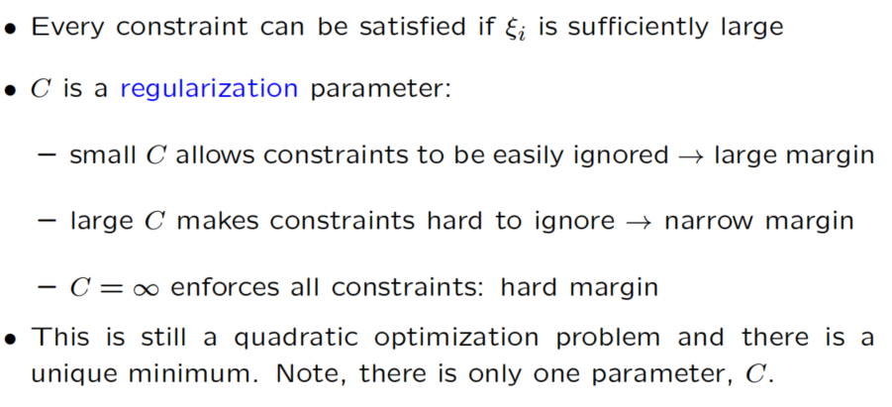
“Soft” margin solution
The optimization problem becomes

Slide 16
“Soft” margin solution
The optimization problem becomes
The dual problem for soft margin classification:
Find α₁…α_{N} such that
Q(α) =Σα_{i} - ½ΣΣα_{i}α_{j}y_{i}y_{j}x_{i}^{T}x_{j} is maximized and
(1) Σα_{i}y_{i} = 0
(2) 0 ≤ α_{i} ≤ C for all α_{i}

Slide 17
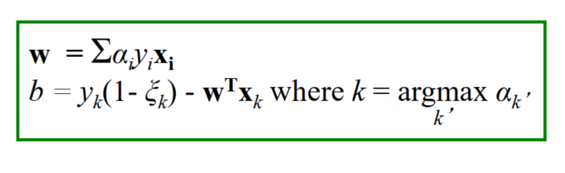
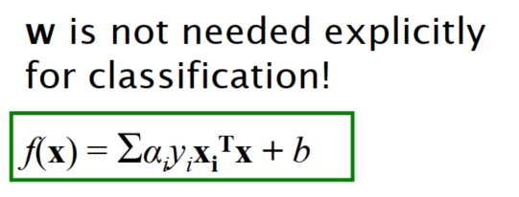
“Soft” margin solution
Solution to the dual problem is:

Slide 18
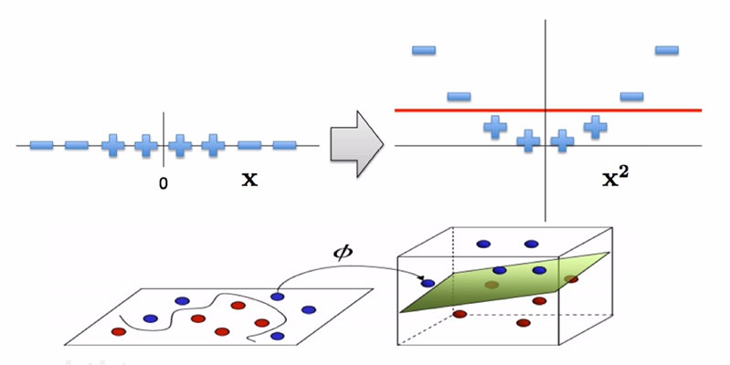
Non-linear SVMs
Datasets that are linearly separable with some noise work out great:
But what are we going to do if the dataset is just too hard?
How about… mapping data to a higher-dimensional space:
0
x
0
x
x²
0
x

Slide 19
Non-linear SVMs: Feature spaces
General idea: the original input space can always be mapped to some higher-dimensional feature space where the training set is separable:
Φ: x → φ(x)

Slide 20
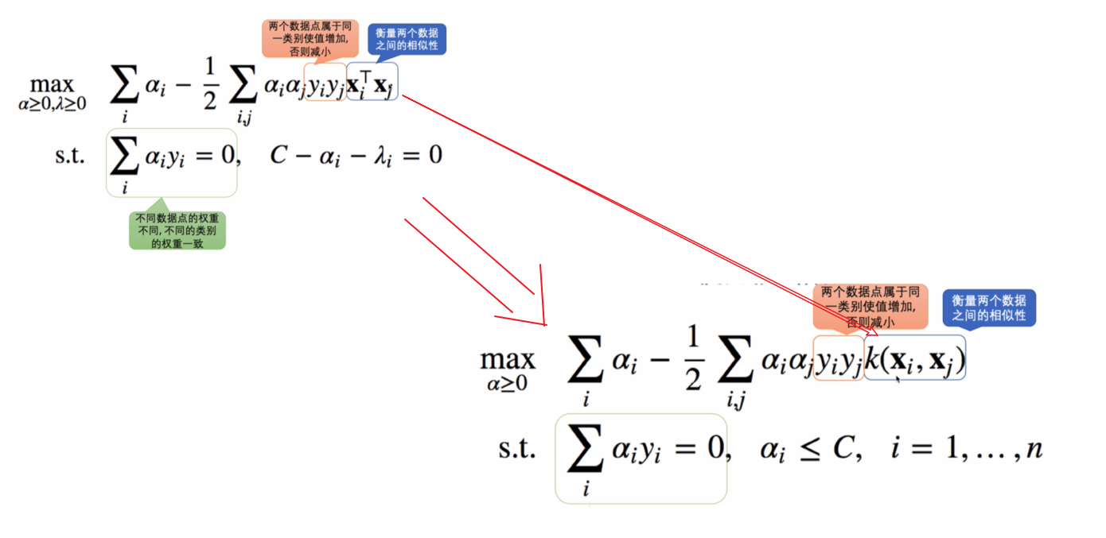
The “Kernel Trick”

Slide 21
What Functions are Kernels?
For some functions K(x_{i},x_{j}) checking that
K(x_{i},x_{j})= φ(x_{i}) ^{T}φ(x_{j}) can be cumbersome.
Mercer’s theorem:
Every semi-positive definite symmetric function is a kernel
Semi-positive definite symmetric functions correspond to a semi-positive definite symmetric Gram matrix:
K(x₁,x₁) | K(x₁,x₂) | K(x₁,x₃) | … | K(x₁,x_{N})
K(x₂,x₁) | K(x₂,x₂) | K(x₂,x₃) |  | K(x₂,x_{N})
… | … | … | … | …
K(x_{N},x₁) | K(x_{N},x₂) | K(x_{N},x₃) | … | K(x_{N},x_{N})
K=

Slide 22
Examples of Kernel Functions
Linear: K(x_{i},x_{j})= x_{i} ^{T}x_{j}
Polynomial of power p: K(x_{i},x_{j})= (1+ x_{i} ^{T}x_{j})^{p}
Gaussian (radial-basis function network):
Sigmoid: K(x_{i},x_{j})= tanh(β₀x_{i} ^{T}x_{j} + β₁)

Slide 23
Non-linear SVMs Mathematically
Dual problem formulation:
The solution is:
Optimization techniques for finding α_{i}’s remain the same!
Find α₁…α_{N} such that
Q(α) =Σα_{i} - ½ΣΣα_{i}α_{j}y_{i}y_{j}K(x_{i}, x_{j}) is maximized and
(1) Σα_{i}y_{i} = 0
(2) α_{i} ≥ 0 for all α_{i}
f(x) = Σα_{i}y_{i}K(x_{i}, x)+ b

Slide 24

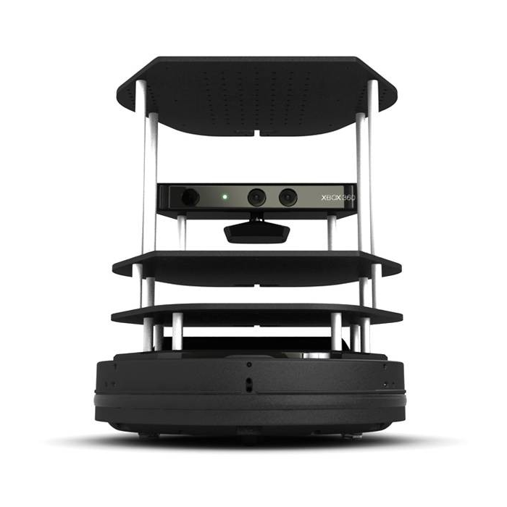

Thanks
贾艳红 Jana
Email:jiayh@mail.sustech.edu.cn

